Slide 1

Browsers -Getting started
JS

Slide 2
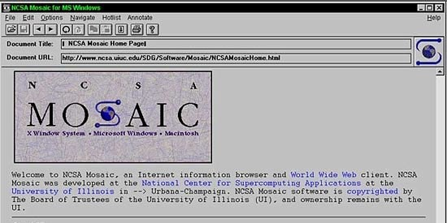
First Web Browser
Andreessen and colleagues leave NCSA to form "Mosaic Communications Corp" (Netscape).

Slide 3
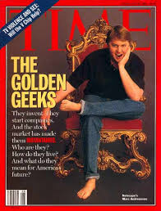
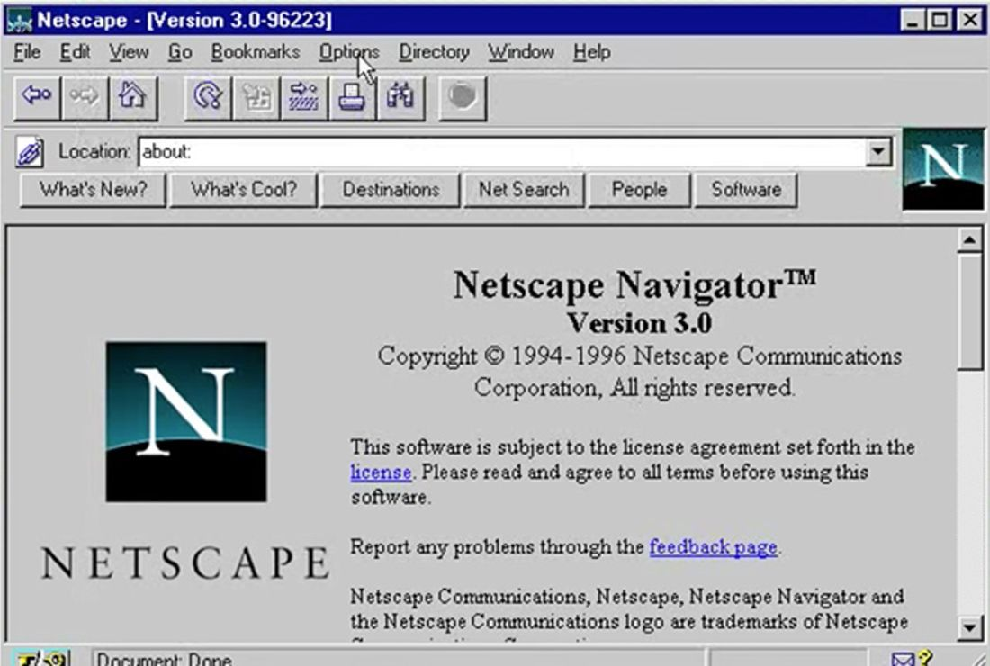
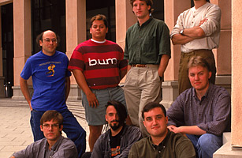
http://www.internethistorypodcast.com/2014/04/on-the-20th-anniversary-an-oral-history-of-netscapes-founding/

Slide 4
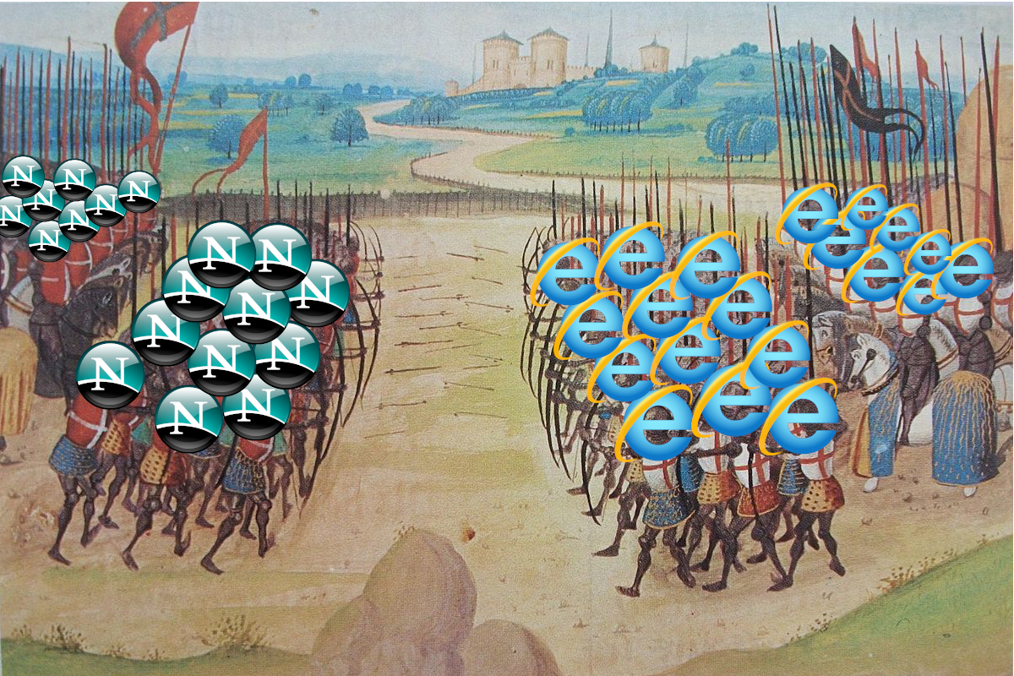
Browser Wars https://www.youtube.com/watch?v=VANORrzKX50
Src: https://medium.com/@traciemasek/a-brief-history-of-the-original-browsers-and-the-first-browser-war-7823fdf756fe

Slide 5
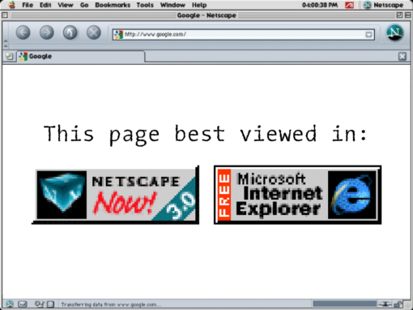

Slide 6
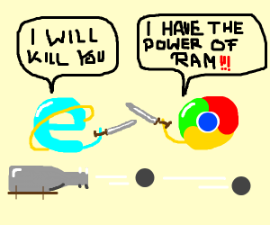
Browser War II

Slide 7
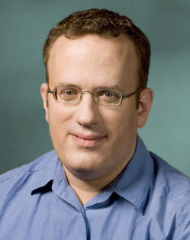
What is JavaScript?
Created by Netscape - 1995
Originally called LiveWire then LiveScript
Developed by Brandon Eich
Named to make use of Java market buzz
IE and Netscape renderings are slightly different
JScript created by Microsoft vs JavaScript
Standardized today as ECMAScript

Slide 8

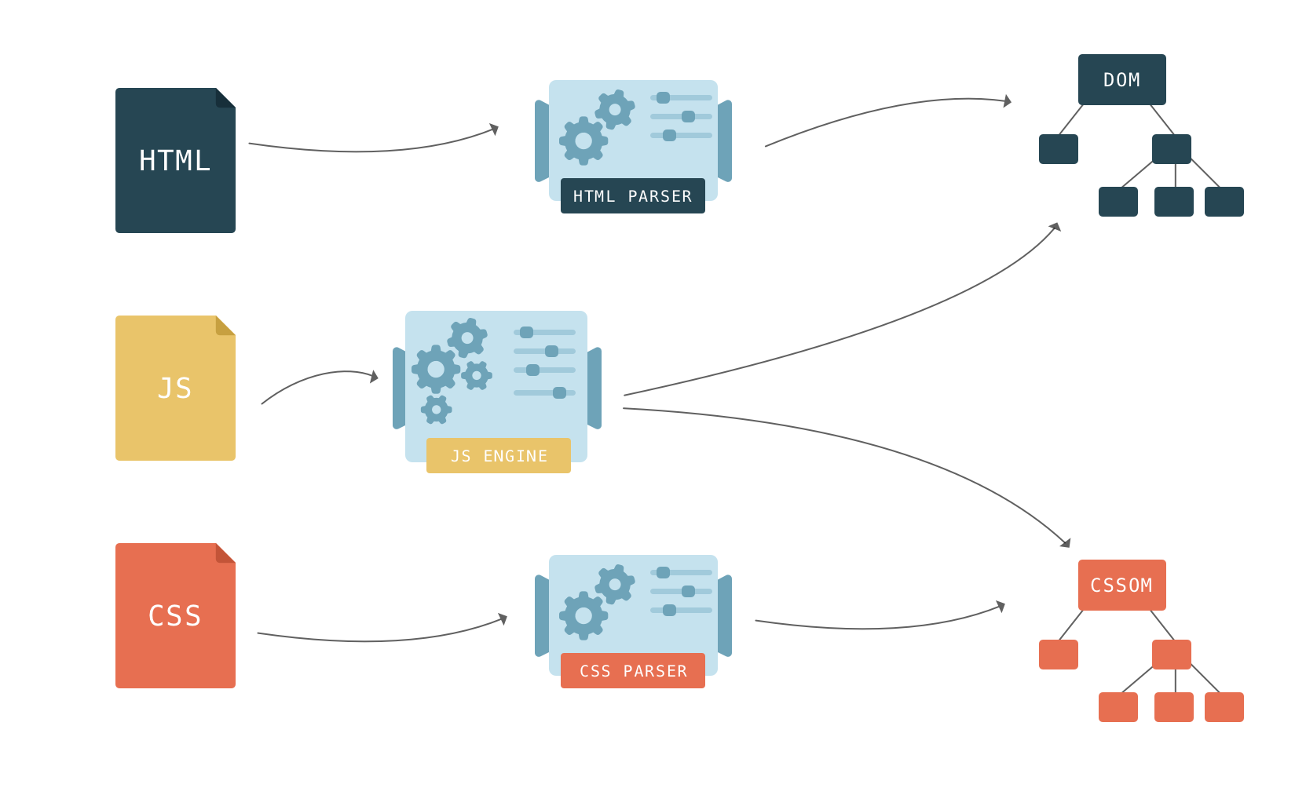

Slide 9
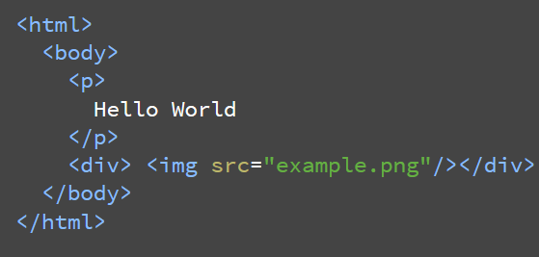
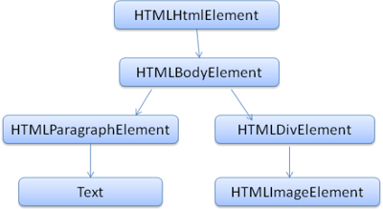
We will only allow at most 20 nested tags

Slide 10

Structure of a Web Browser
User Interface
Browser Engine
Data Storage
Rendering Engine
Networking
JS engine
UI Backend

Slide 11



Rendering Engine
JS Engine
Blink
V8
Gecko
SpiderMonkey
Trident – IE
EdgeHTML - Edge
Chakra
Webkit
Nitro

Slide 12
Operation Sysatn
Operation Sysatn
Operation System
Operation System
Chrome Browser
Chrome Browser
<Script>filename.js</Script>
node filename.js
JavaScript - Sandboxed
JavaScript - Stripped
Chrome Browser
Node.exe
JS engine – V8
JS engine – V8
JavaScript – Run in FE
JavaScript – Run in BE

Slide 13
IP – MAC address – Ports ➔ Discussion
Why IP address when we have MAC address
Why they are called as ports ? Why we need ports?
IMEA – MAC
IP – Mobile Number
Port – USB / C-type

Slide 14
HTTP
Hypertext Transport Protocol
Language of the Web
protocol used for communication between web browsers and web servers
TCP port 80 (443 secure)
RFC 2616 (ver 1.1)

Slide 15
Evolution of HTTP
HTTP/0.9 – The one-line protocol
GET /mypage.html
HTTP/1.0 – Building extensibility
HTTP headers
HTTP/1.1 – The standardized protocol
More than 15 years of extensions
HTTP/2 – A protocol for greater performance
HTTP/3 - HTTP over QUIC
http://www.http2demo.io/

Slide 16
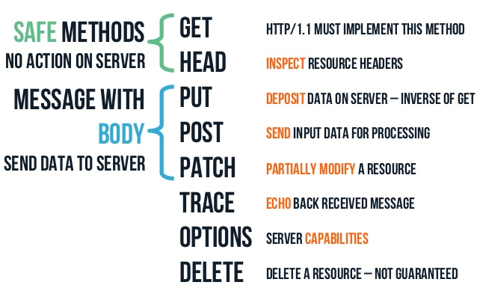
HTTP methods

Slide 17


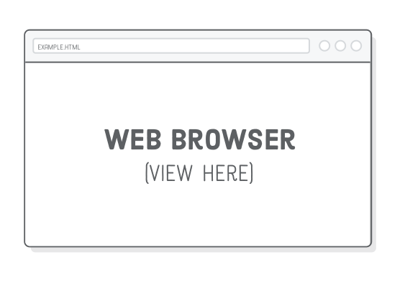


How the Server looks at the URL
Get /index.html
http://234.23.45.6:80/index.html
HTTP request
http://www.guvi.io
HTTP response
(content)
Default browser method is GET

Slide 18
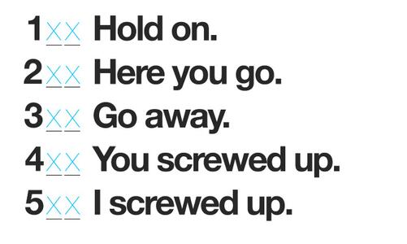
HTTP Return codes

Slide 19
Thanks

